Slide 1
IMPLEMENTATION OF BLOCK CHAIN TECHNOLOGY FOR STUDENT DATABASE IN JAVA PLATFORM
STUDENT :
G. HARI PRASAD
GUIDE :
MR. L ASHOK KUMAR.

Slide 2
ABSTRACT
We all know that the emerging trend in technology is never complete without having secure platform for its applications and Block chain technology promises this cryptography features by employing secured hashing algorithms. Block chain technology uses distributed technology unlike the centralized and decentralized databases in typical internet model which made it theoretically 51% un-hackable in near future. Who knows in future Block Chain Technology may replace whole internet model. In this project we are going to integrate oracle database to implement Block Chain Technology for basic student database in java platform and consequently implementing for any relational database. Further with these works we are willing to monitor big-data such as stock market transactions etc.

Slide 3
LITERATURE SURVEY
Sl No. | PAPER /TITLE | YEAR | PROS | CONS
1. | Decentralizing Privacy: Using Blockchain to Protect Personal Data : (Guy Zyskind MIT Media Lab –IEEE) | 2015 | It just discussed about cryptographic features and a method for cryptography. | It haven’t discussed about application or platforms.
2. | The Blockchain as a Software Connector: (Xiwei Xu NICTA, Sydney -IEEE) | 2016 | It briefly describes about the architecture and the need for different platforms that BC should be provided with. | It haven't discussed any platform for block chain.
3. | Hawk: The Blockchain Model of Cryptography and Privacy-Preserving Smart Contracts: (Ahmed Kosba, University of Maryland-IEEE) | 2016 | It just describes about new platform like Bitcoin for handling transactions | Its completely based on transactions and are being monitored by central managers.

Slide 4
EXISTING SYSTEM
Its limited to most of crypto-currencies like Bitcoin and a trend has started to implement smart contracts through BCT.
Tends to lose some of its cryptographic features when tried to implement in various platforms.
PROPOSED SYSTEM
Provides a convenient platform by using both JAVA platform and ORACLE database without loosing its cryptographic features.

Slide 5
HARDWARE REQUIRED:
Minimum Disk space(primary) 4GB, 128GB/+(SECONDARY)
PROCESSOR:
Intel Core i3 and above OR AMD FX 4100 and above.
SOFTWARE REQUIRED:
Windows 8/8.1/10 (Any version).
JDK ,oracle database 11g express edition,(Oracle dev tools).
JAR FILES : ojdbc6.jar,google-gson-2.6.1jar/newer versions.

Slide 6
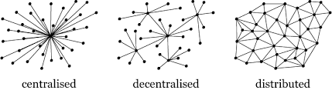
WHY BLOCK CHAIN TECHNOLOGY ?
51% Un-hackable.
No need concept of trusting.

Slide 7
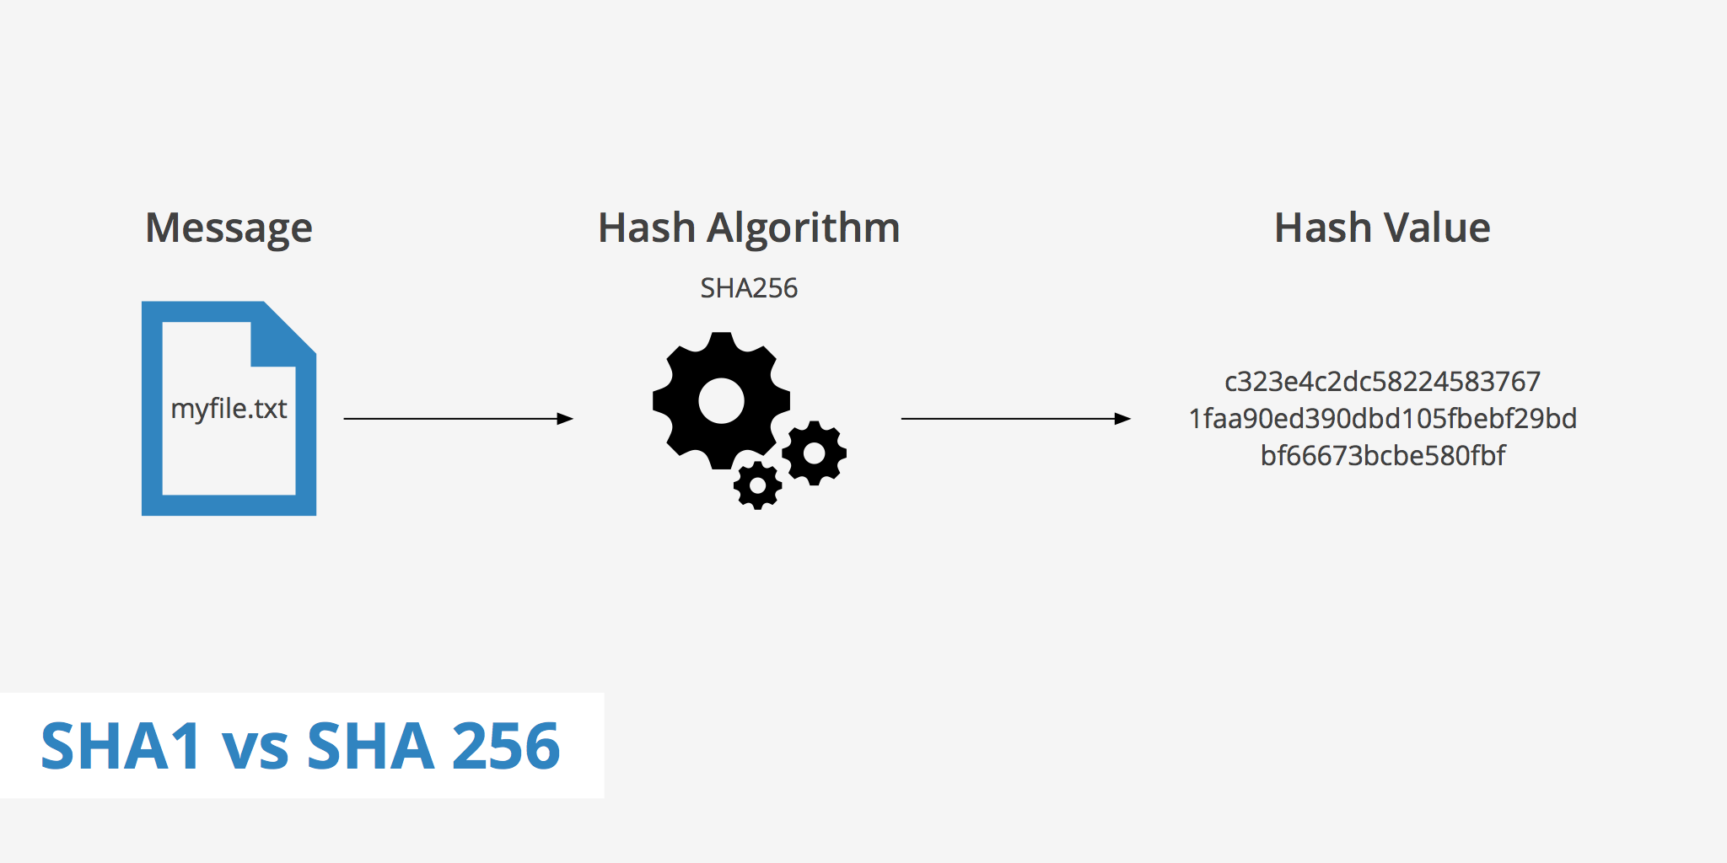
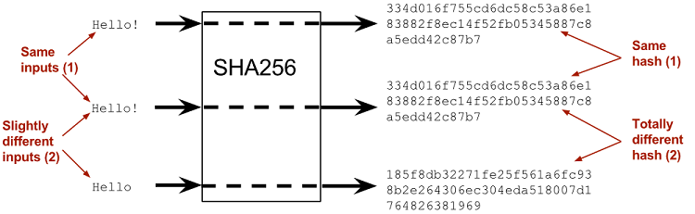
WHAT IS HASH ?

Slide 8
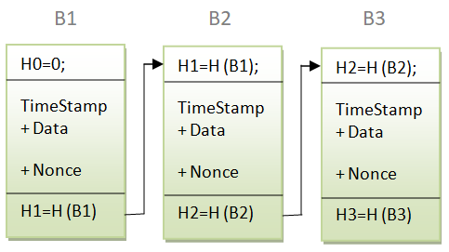
BLOCK DIAGRAM :

Slide 9
UPTO NOW
Basic blocks in java and student chain.
Used inbuilt sha-256 algorithm i.e, message digest.
Used concepts of TIME STAMP,NONCE and DIFFICULTY.
Generated blocks by using google-gson library extension.
Deployed student database in oracle.
By interfacing oracle with java we implemented BCT for Student Data successfully.

Slide 10
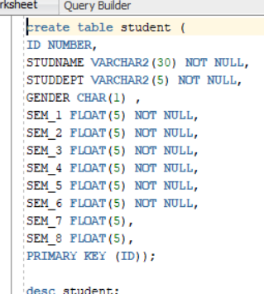
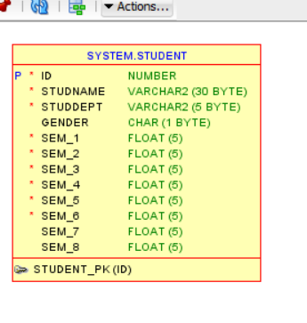
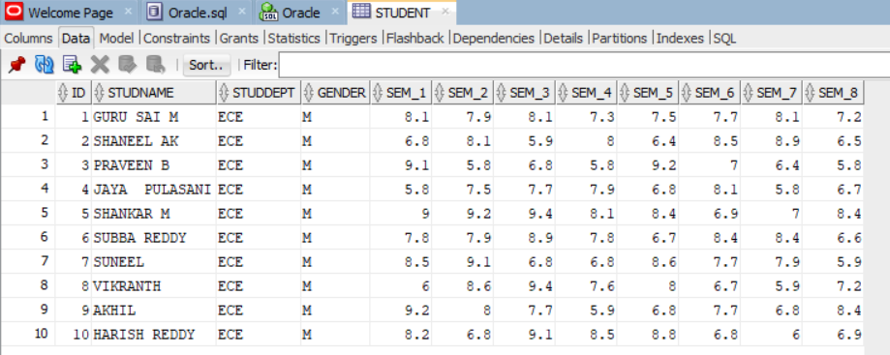

Slide 11
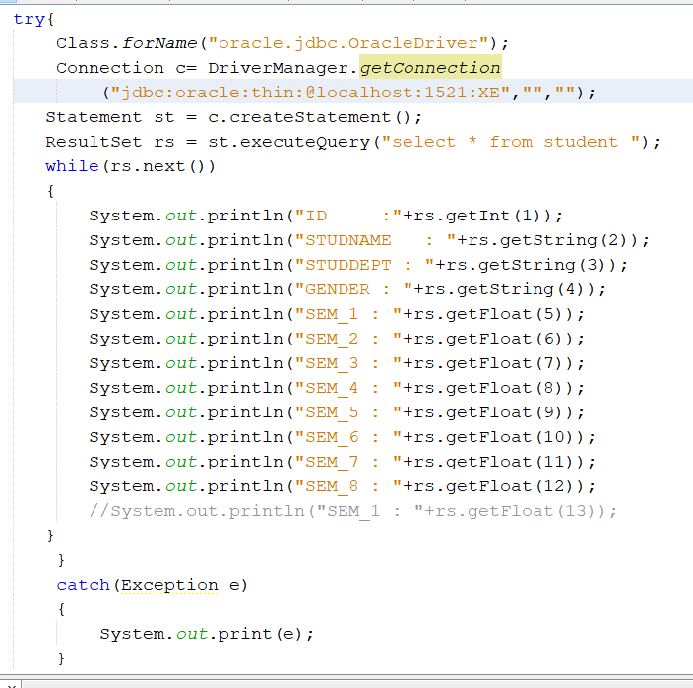
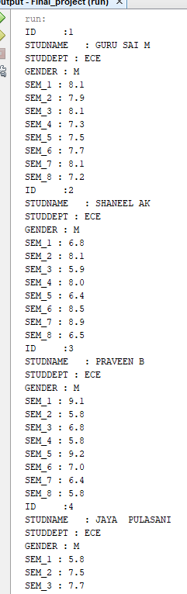

Slide 12
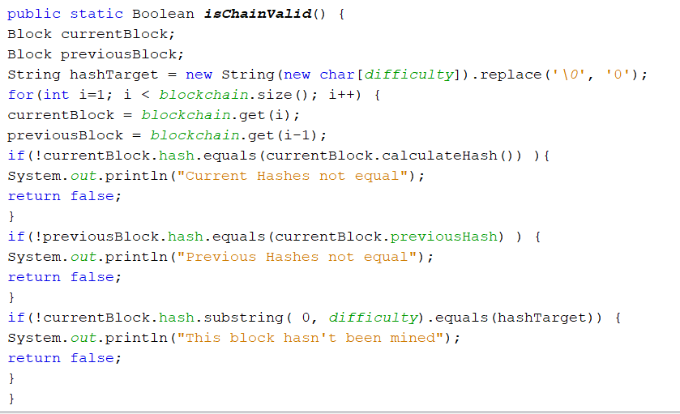

Slide 13
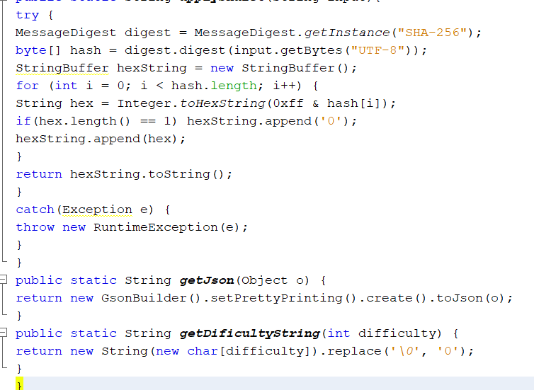

Slide 14
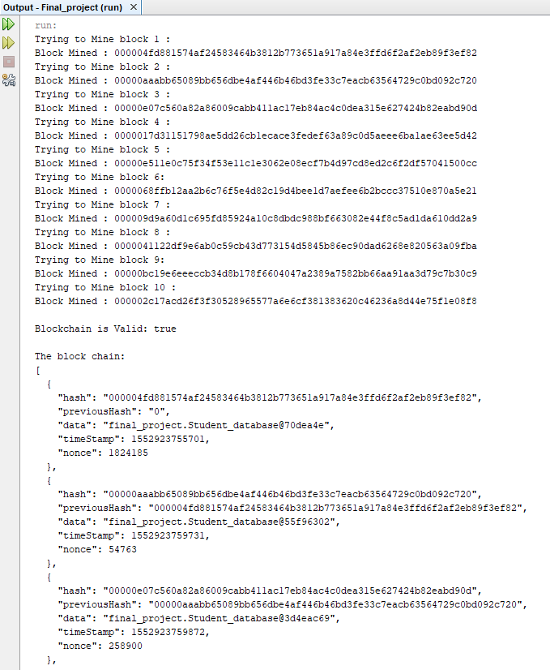

Slide 15
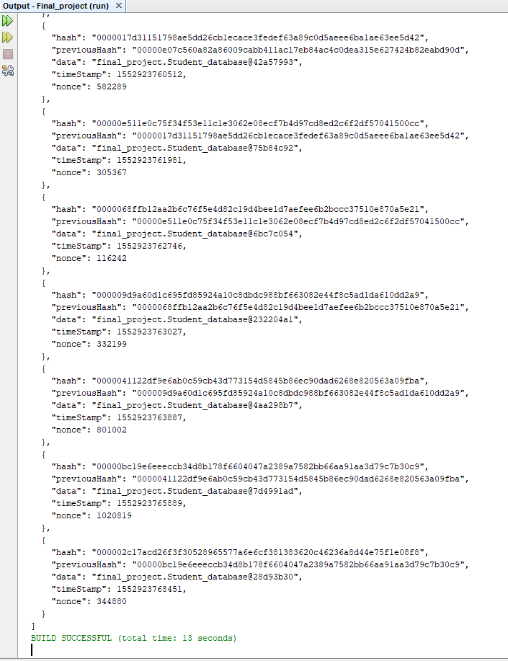

Slide 16
FUTURE OF BLOCK CHAIN TECHNOLOGY
The future of block chain technology looks very promising if you have a look at the investments made by huge companies.
BOA – Got patents for automating process of creating letters of credit using BCT.
Apple – Applied patent for using BCT in timestamping data.
Intel –Working on how hardware that can help BCT.
Goldman Sachs - Planned to open its own bitcoin trading platform.
IBM , GOOGLE ,FACEBOOK,ORACLE, PRUDENTIAL, ROLLS ROYCE, BOEING, BOSCH, ALI BABA, SAMSUNG , MICROSOFT and many more..

Slide 17
REFERENCES
Satoshi Nakamoto, “Bitcoin: A peer-to-peer electronic cash system,” 2008.
Consortium chain development.” Available at:https://github.com/ethereum/wiki/wiki/Cons ortium-Chain- Development.
“Hyperledger project,” 2015. Available at https://www.hyperledger.org/
G. Foroglou and A.L.Tsilidou,“Further applications of the blockchain,”.
C. Noyes, “Bitav: Fast anti-malware by distributed blockchain consensus and feedforward scanning,” arXiv 2016.
M. Sharples and J. Domingue, “The blockchain and kudos: A distributed system for the educational record, reputation and reward.
A. Kosba, A. Miller, E. Shi, Z. Wen, and C. Papamanthou,"Hawk: The blockchain model of cryptography and privacy-preserving smart contracts.

Slide 18

THANK YOU FOR LISTENING.
ANY QUERIES?

